Slide 1
aicuber.co ui sketch
aicuber ui 设计草图

Slide 2
用户画像 who are our users?
初中生和高中生，大学生为主；需求：翻译；doc文档、PPT、PDF、错题及加练、绘图、试卷评分、考试倒计时等；
Middle ，high school students, college students; Requirements: translation; doc documents, PPTs, PDFs, incorrect questions and additional practice, drawing, exam scoring, exam countdown, etc.
our users
???
学生/students
翻译；错题及加练；doc文档；PPT、PDF、模拟真题、试卷评分、考试倒计时等；
Translation; doc documents, PPTs, PDFs, incorrect questions and additional practice, exam scoring, exam countdown, etc.
学生家长/parents
低收入人群，需要AI付费工具解决一部分工作；
偶尔需要付费AI工具，充会员费用贵且无法用满额度；
一人公司或初创公司，需要付费AI工具但希望成本最低；
会议记录、工作流、doc文档、Excel文档、PPT、PDF、绘图、视频制作、行业数据分析及建议等；
Meeting minutes, workflow, doc documents, Excel documents, PPT, PDF, drawing, video production, industry data analysis and suggestions, etc.
公司白领/White-collar worker
Low-income individuals need paid AI tools to handle certain tasks;
Occasionally require paid AI tools, but membership fees are expensive and the usage limits aren't fully utilized;
Sole proprietors or startups need paid AI tools but want to minimize costs.
会议记录、工作流、doc文档、Excel文档、PPT、PDF、绘图、视频制作、行业数据分析及建议、客户回访、问卷调查等；
Meeting minutes, workflow, doc documents, Excel documents, PPT, PDF, drawing, video production, industry data analysis and suggestions, customer follow-up, questionnaire survey, etc.
一人公司/初创公司One-person / Startup company

Slide 3



4类用户需求叠加=aicuber首先要做的
The combined demands of the four types of users = The first thing that aicuber needs to do
公司白领+一人公司/初创公司
White-collar worker+One-person / Startup company
学生+家长
students and parents
会议记录；
工作流；
PPT;PDF;DOC;EXCEL;
绘图/修图；
行业数据分析及建议；
Meeting minutes;
Workflow;
PPT; PDF; DOC; EXCEL;
Drawing/Photo Editing;
Industry Data Analysis and Suggestions;
错题库+加练；
试卷评分；
PPT;PDF;DOC;
考试倒计时；
Error question bank + additional practice;
Test score evaluation;
PPT; PDF; DOC;
Exam countdown；
学生及家长
students and parents
PPT/PDF/DOC…
公司白领/White-collar worker
一人公司/初创公司One-person / Startup company

Slide 4



需求分级Demand classification
付费高级功能
Payment advanced
functions
花费大量token；A large number of tokens
Drawing/Photo Editing;
Make Games;
Make Videos；
付费普通功能
Payment general
functions
花费中等数量token；Moderate tokens;
PPT;PDF;DOC;EXCEL;
Workflow;
Industry Data Analysis and Suggestions;
Error question bank + additional practice;
免费基础功能
Free basic
functions
不花费token或花少量token；free tokens
Meeting minutes;
Translation；
Test score evaluation;

Slide 5

基于以上分析的aicuber.co UI 草图
Based on the above analysis, the UI sketch of aicuber.co
Welcom to aicuber! 欢迎来到aicuber!
Email
Password
Forgot pw?
LOG IN 登录
No account? Registrate now~

Slide 6
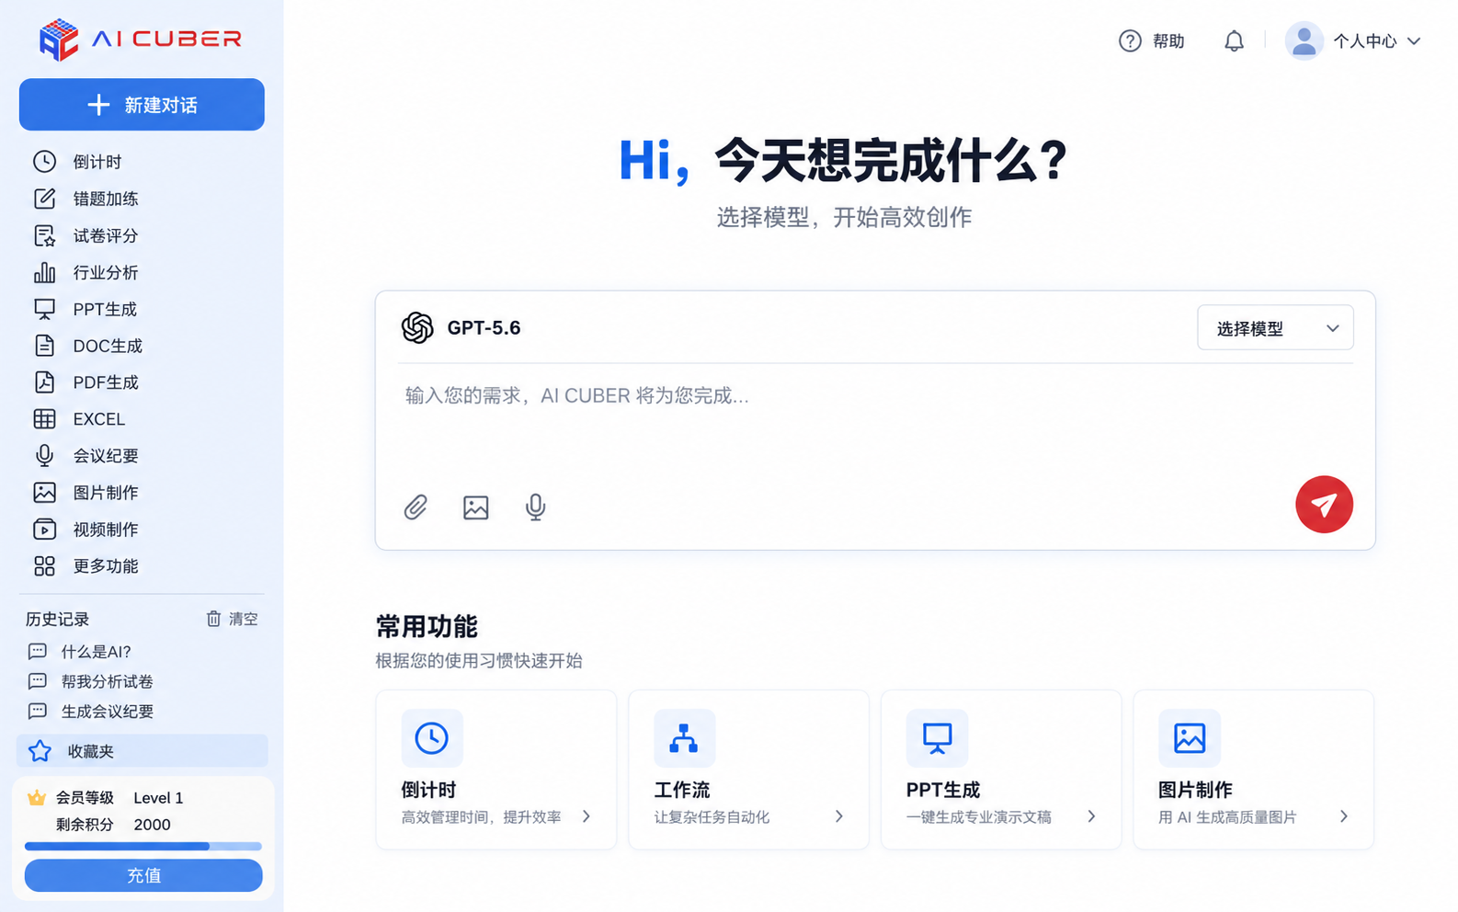

Slide 7
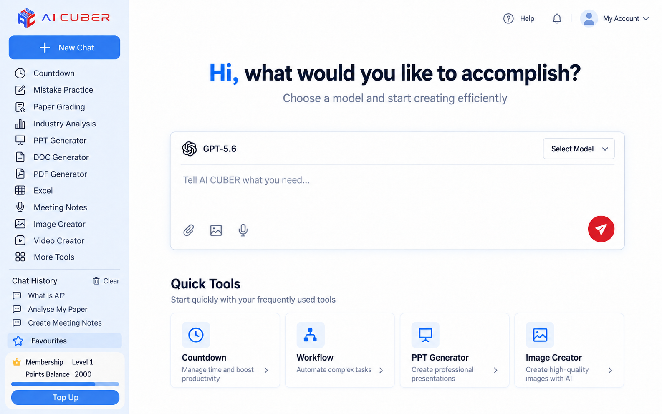

Slide 8
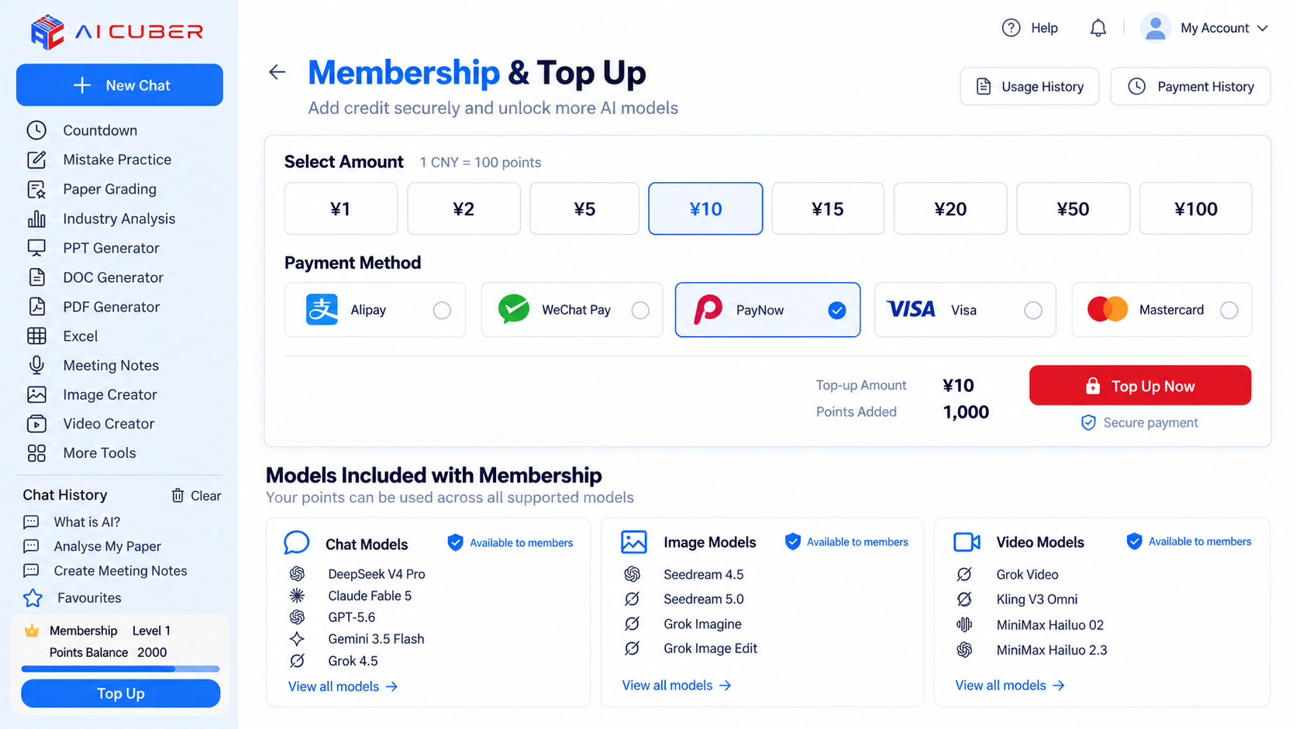

Slide 9
需要进一步讨论的问题：Issues requiring further discussion:
1、网页可否设计成自动适配多国语言？如果不行，初步实现中、英两种语言；
2、充值计算方式和抵扣：1元可以得到多少tokens？还是多少credits？还是多少points？怎么来估算这个数量和单位？
3、充值页面：不同国家汇率不同，1¥、1$、1SGD能够买到tokens数量是不同的，可否实现充值页面自动识别客户所在国家，以所在国家货币单位来计算tokens。
4、充值功能与支付渠道的链接：怎样实现与支付宝，微信、paynow、visa、master的付款连接？是否需要什么手续或备案，毕竟涉及到钱款转账。
1. Can the webpage be designed to automatically adapt to multiple languages? If not, initially support both Chinese and English.
2. Recharge calculation method and deduction: How many tokens, credits, or points does 1 yuan provide? How should this quantity and unit be estimated?
3. Recharge page: Exchange rates vary by country, so 1¥, 1$, or 1SGD can purchase different amounts of tokens. Can the recharge page automatically detect the user's country and calculate token amounts based on their local currency?
4. Integration of recharge function with payment channels: How to connect with Alipay, WeChat Pay, PayNow, Visa, and Mastercard? Are there any required procedures or registrations, given that money transfers are involved?

